Slide 1
Graph Neural Networks
Karimi Zayan ۰ Jed Lim ۰ Mahir Shah ۰ Kabir Jain (JC students from NUS High)
Notes:
Good morning everyone, I will be presenting on my research project real world implementation and security analysis of structured encryption on amazon-web services. (click)

Slide 2





Who are we?
Mahir Shah
Kabir Jain
Lim Li Xin Jed
Karimi Zayan

Slide 3
Introduction
Vertex
Graphs are mathematical structures which are used to model many relationships
Edge

Slide 4
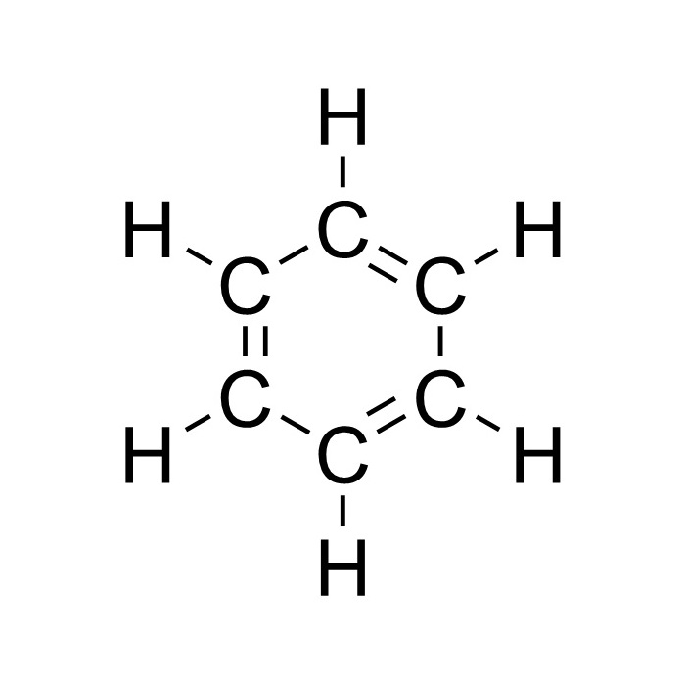
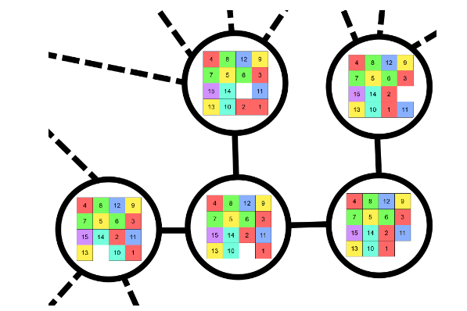
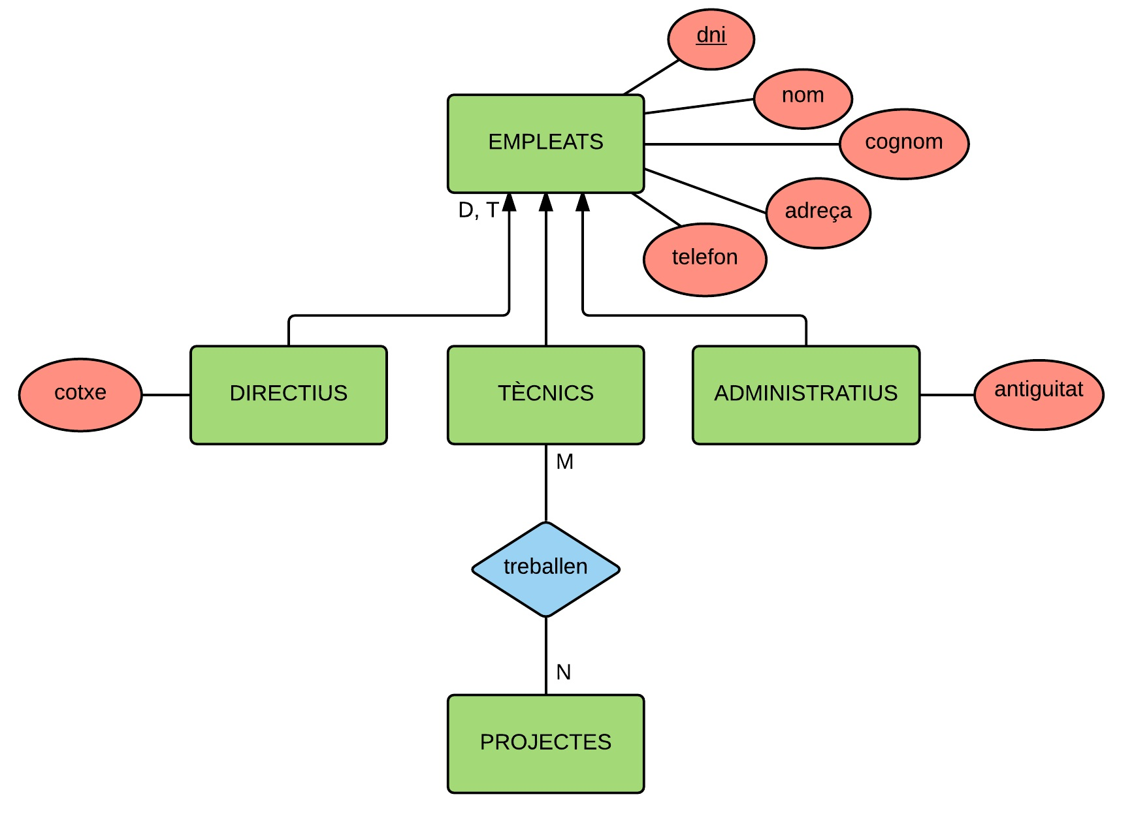
Introduction
A lot of data can be expressed in graphs

Slide 5
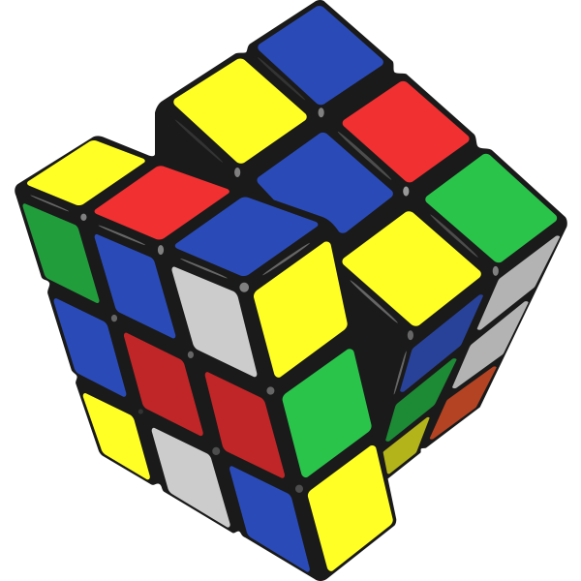
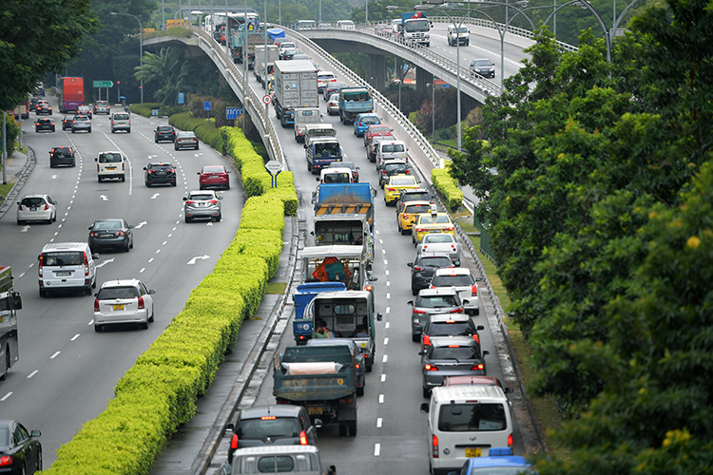

Introduction
Neural Combinatorial Optimization
Need for graph neural networks (usecase)
Traffic and Networking
Chemistry

Slide 6
Introduction
What we will be covering
Recap on ANN and implementation
Recap on Graph theory and implementation
Spatial GNNs
Different existing Architectures
Implementation of Graph Neural Networks
GSP and Spectral GNNs and implementation

Slide 7
1
Artificial Neural Networks
Activation Functions, Neurons
2
Graph Theory
Nodes and Edges
3
Graph Neural Networks
Message Passing, GCN
4
Applications
Node, Edge and Graph Classification
ANNs
Graph Theory
Graph Neural Networks
Applications

Slide 8
Artificial Neural Networks
ANNs
Graph Theory
Graph Neural Networks
Applications

Slide 9
What is a Neural Network?
Inspired by Neural Networks in the brain
Made of multiple layers of neurons
Known as deep due to having multiple layers
…
Input
Hidden Layer
Output
ANNs
Graph Theory
Graph Neural Networks
Applications

Slide 10
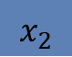
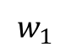
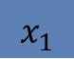
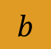
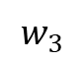
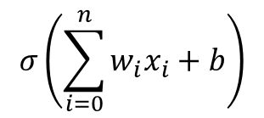
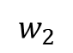
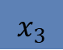
Neuron
Receives an input, processes it and produces an outputs
Connected to other neurons, with weights being the strength
Has an activation function to produce an output
$$x_{1}$$
$$w_{1}$$
Output
$$w_{2}$$
$$σ\left(\sum_{i=0}^{n}{w_{i}x_{i}}+b\right)$$
$$x_{2}$$
$$b$$
$$w_{3}$$
$$x_{3}$$
Activation function introduces non-linearity into the model
ANNs
Graph Theory
Graph Neural Networks
Applications

Slide 11

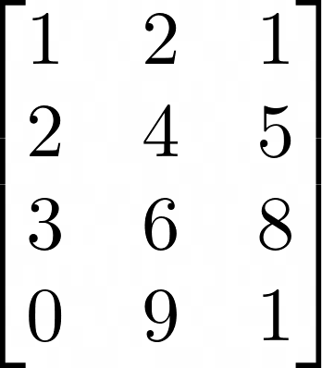
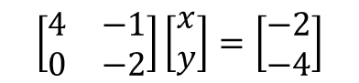
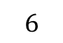
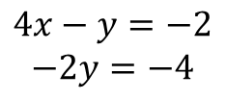
Linear Algebra
Scalar
Vector
Matrix
$$6$$
$$4x−y=−2$$
$$−2y=−4$$
$$\left[\begin{matrix}4 & −1 \\ 0 & −2\end{matrix}\right]\left[\begin{matrix}x \\ y\end{matrix}\right]=\left[\begin{matrix}−2 \\ −4\end{matrix}\right]$$
ANNs
Graph Theory
Graph Neural Networks
Applications

Slide 12
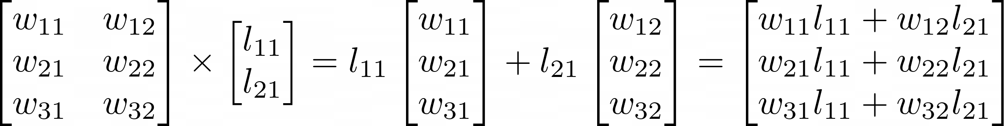
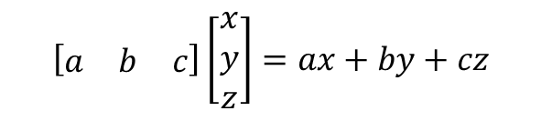
Matrix Multiplication
$$\left[\begin{matrix}a & b & c\end{matrix}\right]\left[\begin{matrix}x \\ y \\ z\end{matrix}\right]=ax+by+cz$$
$$\left[\begin{matrix}w_{11} & w_{12} \\ w_{21} & w_{22}\end{matrix}\right]\left[\begin{matrix}x_{11} & x_{12} \\ x_{21} & x_{22}\end{matrix}\right]=\left[\begin{matrix}w_{11}x_{11}+w_{12}x_{21} & w_{11}x_{12}+w_{12}x_{22} \\ w_{21}x_{11}+w_{22}x_{21} & w_{21}x_{12}+w_{22}x_{22}\end{matrix}\right]$$
ANNs
Graph Theory
Graph Neural Networks
Applications

Slide 13
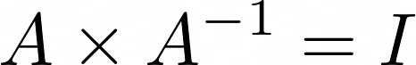
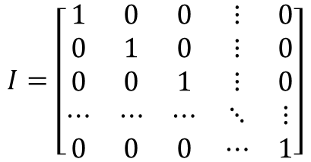
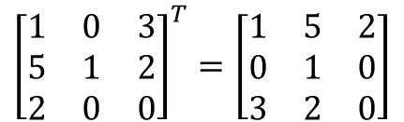
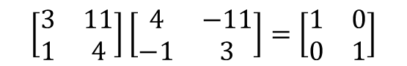
Basic Matrix Knowledge
Addition and subtraction are element-wise
Multiplying a scalar by a matrix or a vector is elementwise
Inversion
$$\left[\begin{matrix}3 & 11 \\ 1 & 4\end{matrix}\right]\left[\begin{matrix}4 & −11 \\ −1 & 3\end{matrix}\right]=\left[\begin{matrix}1 & 0 \\ 0 & 1\end{matrix}\right]$$
Identity Matrix
$$I=\left[\begin{matrix}1 & 0 & 0 & ⋮ & 0 \\ 0 & 1 & 0 & ⋮ & 0 \\ 0 & 0 & 1 & ⋮ & 0 \\ ⋯ & ⋯ & ⋯ & ⋱ & ⋮ \\ 0 & 0 & 0 & ⋯ & 1\end{matrix}\right]$$
Transposition
$${\left[\begin{matrix}1 & 0 & 3 \\ 5 & 1 & 2 \\ 2 & 0 & 0\end{matrix}\right]}^{T}=\left[\begin{matrix}1 & 5 & 2 \\ 0 & 1 & 0 \\ 3 & 2 & 0\end{matrix}\right]$$
ANNs
Graph Theory
Graph Neural Networks
Applications

Slide 14
Original Motivation
Vectors
Vectors are n-dimensional arrows from origin
Matrices
Matrices are transforms which scale and rotate vectors. (They Change the vector)
$$\left[\begin{matrix}4 & −1 \\ 0 & −2\end{matrix}\right]\left[\begin{matrix}1 \\ 2\end{matrix}\right]=\left[\begin{matrix}−2 \\ −4\end{matrix}\right]$$
ANNs
ANNs
Graph Theory
Graph Theory
Graph Neural Networks
Graph Neural Networks
Applications
Applications

Slide 15
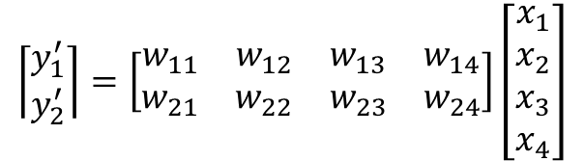
Mathematical representation of neural networks
Inspired by Neural Networks in the brain
Made of multiple layers of neurons
Known as deep due to having multiple layers
$$\left\lceil \begin{matrix}y_{1}^{′} \\ y_{2}^{′}\end{matrix}\right\rceil =\left[\begin{matrix}w_{11} & w_{12} & w_{13} & w_{14} \\ w_{21} & w_{22} & w_{23} & w_{24}\end{matrix}\right]\left[\begin{matrix}x_{1} \\ x_{2} \\ x_{3} \\ x_{4}\end{matrix}\right]$$
ANNs
Graph Theory
Graph Neural Networks
Applications

Slide 16
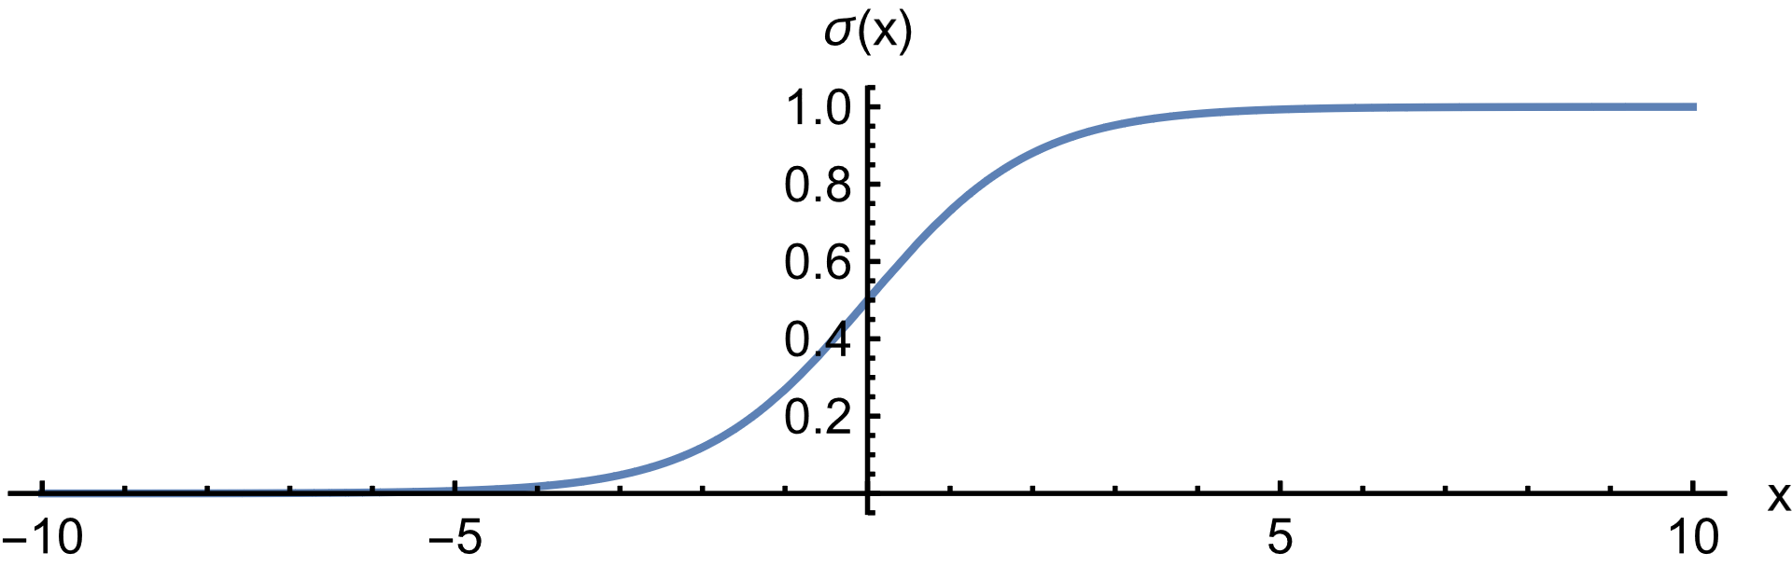
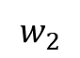
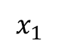
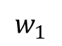
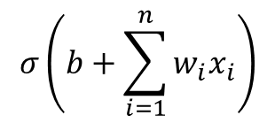
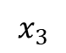
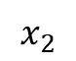
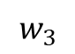
Activation Function
$$w_{1}$$
$$x_{1}$$
b
$$σ\left(b+\sum_{i=1}^{n}{w_{i}x_{i}}\right)$$
$$w_{2}$$
$$x_{2}$$
$$w_{3}$$
$$x_{3}$$
Introduce non-linearity into the system
ANNs
Graph Theory
Graph Neural Networks
Applications

Slide 17
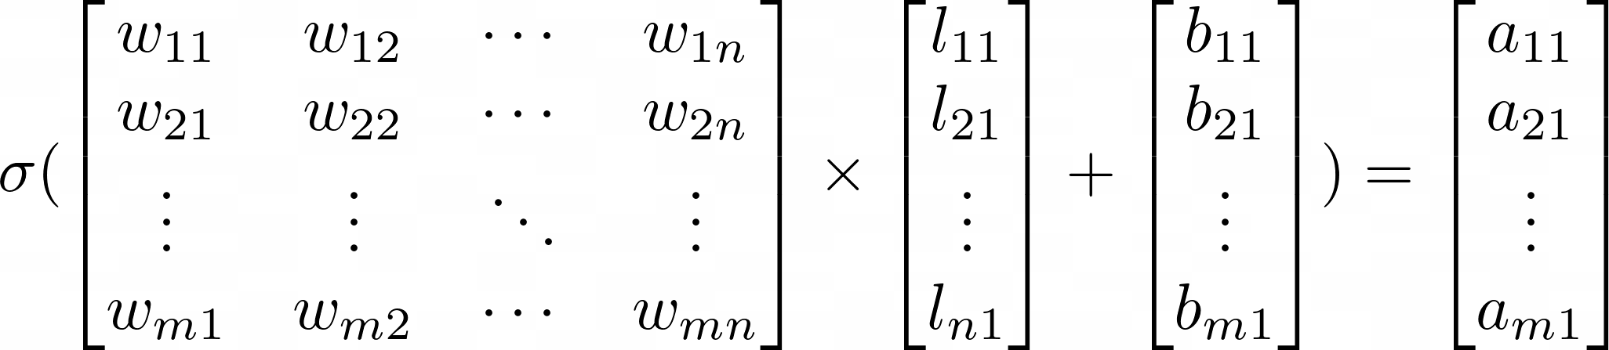
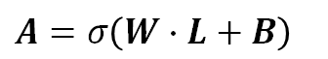
Layer Activation
$A=σ\left(W∙L+B\right)$
Matrix multiplication enables efficient evaluation
ANNs
Graph Theory
Graph Neural Networks
Applications

Slide 18
Why do DNNs work?
Complexity
NNs have a large amount of trainable parammeters which allows is to be flexible and fit a large amount of data
Non-linearity
Repeated linearity can mimic non linearity and the activation function adds more non-linear character
ANNs
ANNs
Graph Theory
Graph Theory
Graph Neural Networks
Graph Neural Networks
Applications
Applications
Notes:
Deep neural networks have the capability to handle more intricate problems and a wider range of data types due to their complexity which is due to the amount of weights and biases. However, this complexity also necessitates the use of large amounts of training data and can make training the network a challenging task. The Activation function also introduces non-linearity to the neural network that allows it to be flexible

Slide 19
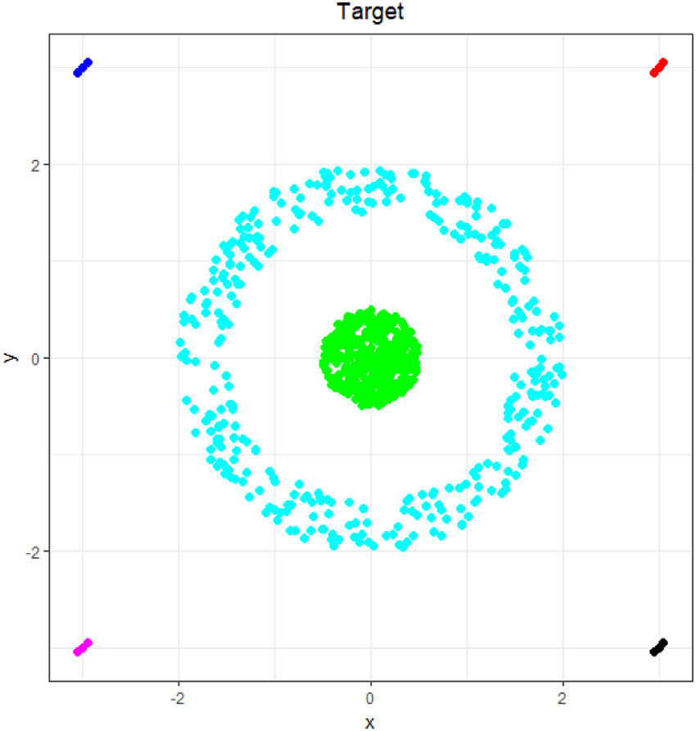
Why do DNNs work?

Slide 20
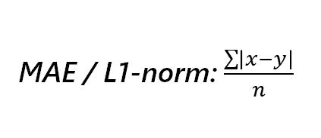
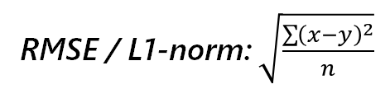
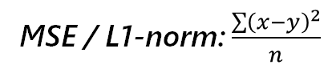
Loss Function
Describes how well / poorly the model is performing
Classification
Regression
Binary Crossentropy
MAE / L1-norm: $\frac{\sum{\left|x−y\right|}}{n}$
Categorical Crossentropy
MSE / L1-norm: $\frac{\sum{{\left(x−y\right)}^{2}}}{n}$
RMSE / L1-norm: $\sqrt{\frac{\sum{{\left(x−y\right)}^{2}}}{n}}$
ANNs
Graph Theory
Graph Neural Networks
Applications

Slide 21
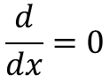
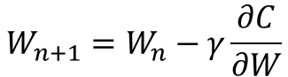
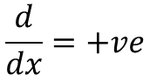
Backward Propagation
$$W_{n+1}=W_{n}−γ\frac{∂C}{∂W}$$
$$\frac{d}{dx}=+ve$$
Implies that the x-step should be to the left
$$\frac{d}{dx}=0$$
ANNs
ANNs
Graph Theory
Graph Theory
Graph Neural Networks
Graph Neural Networks
Applications
Applications
Notes:
We will be using the fact that following the gradient of an n-dimensional function will allow us to reach the local maximum. Likewise, if we go down the gradient, we find a way to go down and find the local minima, or hopefully even a global minima of the cost function for changing weights

Slide 22

Notebook work with PyTorch https://tinyurl.com/fossasia-ann
ANNs
ANNs
Graph Theory
Graph Theory
Graph Neural Networks
Graph Neural Networks
Applications
Applications
Notes:
We will be using the fact that following the gradient of an n-dimensional function will allow us to reach the local maximum. Likewise, if we go down the gradient, we find a way to go down and find the local minima, or hopefully even a global minima of the cost function for changing weights

Slide 23
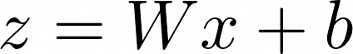
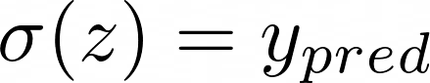
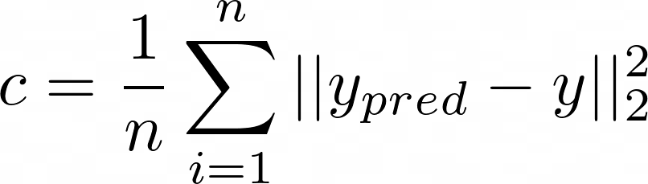
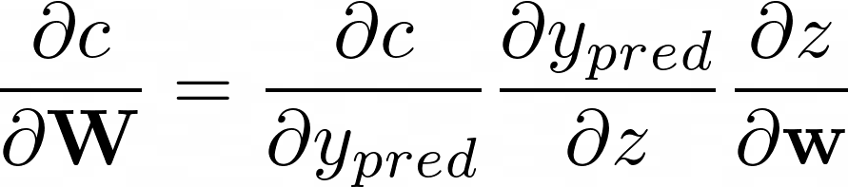
Backward Propagation
ANNs
ANNs
Graph Theory
Graph Theory
Graph Neural Networks
Graph Neural Networks
Applications
Applications
Notes:
We will be using the fact that following the gradient of an n-dimensional function will allow us to reach the local maximum. Likewise, if we go down the gradient, we find a way to go down and find the local minima, or hopefully even a global minima of the cost function for changing weights

Slide 24
Graph Theory
ANNs
Graph Theory
Graph Neural Networks
Applications

Slide 25
What are graphs?
Graphs are mathematical structures which are used to model many relationships
ANNs
Graph Theory
Graph Neural Networks
Applications

Slide 26
What are graphs?
Elements
Connections
ANNs
Graph Theory
Graph Neural Networks
Applications

Slide 27
Types of Graphs
ANNs
Graph Theory
Graph Neural Networks
Applications

Slide 28
Types of Graphs
Directed
ANNs
Graph Theory
Graph Neural Networks
Applications

Slide 29
Types of Graphs
Undirected Graph
Directed Graph
ANNs
Graph Theory
Graph Neural Networks
Applications

Slide 30
Undirected Graph
Directed Graph
Degree Matrix
1 2 3 4
2
1
4 3 2 1
4
3
ANNs
Graph Theory
Graph Neural Networks
Applications

Slide 31
Undirected Graph
Directed Graph
Degree Matrix
1 2 3 4
2
1
2
4 3 2 1
4
3
ANNs
Graph Theory
Graph Neural Networks
Applications

Slide 32
Undirected Graph
Directed Graph
Degree Matrix
1 2 3 4
2
1
2 0 0 0
4 3 2 1
0 3 0 0
4
0 0 2 0
3
0 0 0 1
ANNs
Graph Theory
Graph Neural Networks
Applications

Slide 33
1 2 3 4
2
2 0 0 0
4 3 2 1
2
0 3 0 0
2
0 0 2 0
1
0 0 0 1
Undirected Graph
Directed Graph
Adjacency Matrix
2
1
Matrix used to represent the graph via the connections between nodes
4
3
ANNs
Graph Theory
Graph Neural Networks
Applications

Slide 34
Undirected Graph
Directed Graph
Adjacency Matrix
1 2 3 4
2
1
4 3 2 1
4
3
ANNs
Graph Theory
Graph Neural Networks
Applications

Slide 35
Undirected Graph
Directed Graph
Adjacency Matrix
1 2 3 4
2
1
1
1
4 3 2 1
4
3
ANNs
Graph Theory
Graph Neural Networks
Applications

Slide 36
2 0 0 0
0 3 0 0
0 0 2 0
0 0 0 1
Undirected Graph
Directed Graph
Adjacency Matrix
1 2 3 4
2
1
0
1
1
0
4 3 2 1
4
1
0
1
1
1
1
0
0
3
0
1
0
0
ANNs
Graph Theory
Graph Neural Networks
Applications

Slide 37

Notebook work with Networkx https://tinyurl.com/fossasia-networkx
ANNs
Graph Theory
Graph Neural Networks
Applications

Slide 38
Graph Neural Networks
ANNs
Graph Theory
Graph Neural Networks
Applications

Slide 39

Inductive Tasks
Examples
Molecules
Many, small graphs
Perform train, test, validation splits as per normal
ANNs
Graph Theory
Graph Neural Networks
Applications

Slide 40
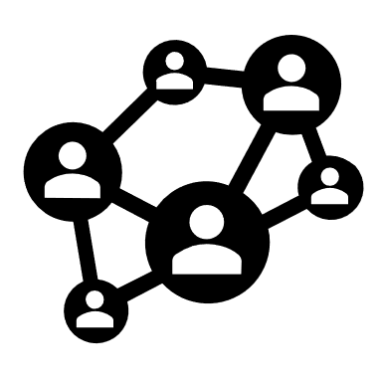
Transductive Tasks
Examples
Friendship Networks
Only one, massive graph
During training, mask parts of graph and ask for predictions
ANNs
Graph Theory
Graph Neural Networks
Applications

Slide 41
Inductive Tasks
Data Organization
One or many graphs for a given model.
Train-Test Split
Can split the training and testing set based on graphs or nodes in the graph
ANNs
Graph Theory
Graph Neural Networks
Applications

Slide 42
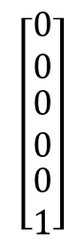
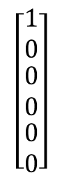
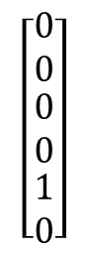
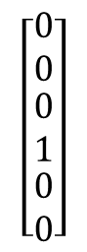





Graph Embeddings
Node Legend
$$\left[\begin{matrix}1 \\ 0 \\ \begin{matrix}0 \\ 0 \\ \begin{matrix}0 \\ 0\end{matrix}\end{matrix}\end{matrix}\right]$$
$$\left[\begin{matrix}0 \\ 1 \\ \begin{matrix}0 \\ 0 \\ \begin{matrix}0 \\ 0\end{matrix}\end{matrix}\end{matrix}\right]$$
$$\left[\begin{matrix}0 \\ 0 \\ \begin{matrix}1 \\ 0 \\ \begin{matrix}0 \\ 0\end{matrix}\end{matrix}\end{matrix}\right]$$
$$\left[\begin{matrix}0 \\ 0 \\ \begin{matrix}0 \\ 1 \\ \begin{matrix}0 \\ 0\end{matrix}\end{matrix}\end{matrix}\right]$$
$$\left[\begin{matrix}0 \\ 0 \\ \begin{matrix}0 \\ 0 \\ \begin{matrix}1 \\ 0\end{matrix}\end{matrix}\end{matrix}\right]$$
$$\left[\begin{matrix}0 \\ 0 \\ \begin{matrix}0 \\ 0 \\ \begin{matrix}0 \\ 1\end{matrix}\end{matrix}\end{matrix}\right]$$
Graph
Edge Legend
$$[\begin{matrix}1 & 0 & 0\end{matrix}]$$
$$[\begin{matrix}0 & 1 & 0\end{matrix}]$$
$$[\begin{matrix}0 & 0 & 1\end{matrix}]$$
Each node and edge must have an embedding
For classes of nodes / edge (e.g. atoms and bonds), can use one-hot encoding
ANNs
Graph Theory
Graph Neural Networks
Applications

Slide 43









Usable Graphs
Graphs with Node and/or Edge Embeddings
$$\left[\begin{matrix}⋮ \\ x_{0} \\ x_{1} \\ x_{2} \\ x_{3} \\ ⋮\end{matrix}\right]$$
$$\left[\begin{matrix}⋮ \\ x_{0} \\ x_{1} \\ x_{2} \\ x_{3} \\ ⋮\end{matrix}\right]$$
Every node and/or every edge must have a vector associated with it. The vector must be the same size for every node or every edge. These are also known as the features.
$$\left[\begin{matrix}⋮ \\ x_{0} \\ x_{1} \\ x_{2} \\ x_{3} \\ ⋮\end{matrix}\right]$$
$$\left[\begin{matrix}⋮ \\ x_{0} \\ x_{1} \\ x_{2} \\ x_{3} \\ ⋮\end{matrix}\right]$$
$$\left[\begin{matrix}⋮ \\ x_{0} \\ x_{1} \\ x_{2} \\ x_{3} \\ ⋮\end{matrix}\right]$$
$$\left[\begin{matrix}⋮ \\ x_{0} \\ x_{1} \\ x_{2} \\ x_{3} \\ ⋮\end{matrix}\right]$$
$$\left[\begin{matrix}⋮ \\ x_{0} \\ x_{1} \\ x_{2} \\ x_{3} \\ ⋮\end{matrix}\right]$$
$$\left[\begin{matrix}⋮ \\ x_{0} \\ x_{1} \\ x_{2} \\ x_{3} \\ ⋮\end{matrix}\right]$$
$$\left[\begin{matrix}⋮ \\ x_{0} \\ x_{1} \\ x_{2} \\ x_{3} \\ ⋮\end{matrix}\right]$$
ANNs
Graph Theory
Graph Neural Networks
Applications
Notes:
Also known as the node embedding or node featues

Slide 44








Usable Graphs
Graphs with Node and/or Edge Target Embeddings
$$\left[\begin{matrix}⋮ \\ y_{0} \\ y_{1} \\ y_{2} \\ y_{3} \\ ⋮\end{matrix}\right]$$
$$\left[\begin{matrix}⋮ \\ y_{0} \\ y_{1} \\ y_{2} \\ y_{3} \\ ⋮\end{matrix}\right]$$
$$\left[\begin{matrix}⋮ \\ x_{0} \\ x_{1} \\ x_{2} \\ x_{3} \\ ⋮\end{matrix}\right]$$
Every Node and/or every Edge must have another vector associated with it. The vector must be the same size for every node or every edge. These are known as the Target embeddings.
$$\left[\begin{matrix}⋮ \\ y_{0} \\ y_{1} \\ y_{2} \\ y_{3} \\ ⋮\end{matrix}\right]$$
$$\left[\begin{matrix}⋮ \\ y_{0} \\ y_{1} \\ y_{2} \\ y_{3} \\ ⋮\end{matrix}\right]$$
$$\left[\begin{matrix}⋮ \\ y_{0} \\ y_{1} \\ y_{2} \\ y_{3} \\ ⋮\end{matrix}\right]$$
$$\left[\begin{matrix}⋮ \\ y_{0} \\ y_{1} \\ y_{2} \\ y_{3} \\ ⋮\end{matrix}\right]$$
$$\left[\begin{matrix}⋮ \\ y_{0} \\ y_{1} \\ y_{2} \\ y_{3} \\ ⋮\end{matrix}\right]$$
$$\left[\begin{matrix}⋮ \\ y_{0} \\ y_{1} \\ y_{2} \\ y_{3} \\ ⋮\end{matrix}\right]$$
ANNs
Graph Theory
Graph Neural Networks
Applications
Notes:
Also known as the node embedding or node featues

Slide 45



MLPs?
MLP
$$x$$
$$y$$
MLPs take in vectors and output vectors
MLPs fail to account for structural information
Graphs are not vectors. How do we input graphs into an MLP?
ANNs
Graph Theory
Graph Neural Networks
Applications

Slide 46
CNNs?
!
Images can be represented as graphs
Graphs are not structured like images. No “kernel” can be defined.
ANNs
Graph Theory
Graph Neural Networks
Applications

Slide 47
Basic Structure of Every GNN
Skip Connection
Sampling
Operator
Convolution
Operator
Pooling Operator
ANNs
Graph Theory
Graph Neural Networks
Applications

Slide 48
Types of GNNs
Spatial GNNs
Message Passing Convolution, Convolution via diffusion
1
Spectral GNNs
Convolution based on defined Fourier Basis
2
ANNs
Graph Theory
Graph Neural Networks
Applications
Notes:
We will begin by modelling the diver’s statics. (click)

Slide 49
















Propagating Signals through time
$$x_{1}$$
$$x_{1}$$
$$x_{1}$$
$$x_{3}$$
$$x_{−2}$$
$$x_{0}$$
$$x_{0}$$
$$x_{0}$$
$$x_{2}$$
$$x_{−1}$$
$$x_{2}$$
$$x_{−1}$$
…
$$\text{x}$$
$$\text{x}\text{′}=shift(\text{x})$$
$$\text{x}\text{′′}={shift}^{2}(\text{x})$$
Signal Diffusion
Time Convolution Operator
The signal is transmitted
or diffused over time.
Weighted sum of time shifted inputs
$$h⋆\text{x}\text{ =}\sum_{i=0}^{n}{h_{i}{\text{x}}^{(n)}}$$
ANNs
Graph Theory
Graph Neural Networks
Applications

Slide 50









Graph representation of Time
$$x_{1}$$
$$x_{1}$$
$$x_{1}$$
$$x_{3}$$
$$x_{−2}$$
$$x_{0}$$
$$x_{0}$$
$$x_{0}$$
$$x_{2}$$
$$x_{−1}$$
$$x_{2}$$
$$x_{−1}$$
…
$$\text{x}$$
$$\text{x}\text{′}=shift(\text{x})$$
$$\text{x}\text{′′}={shift}^{2}(\text{x})$$
$$\left[\begin{matrix}⋮ \\ x_{0} \\ x_{1} \\ x_{2} \\ x_{3} \\ ⋮\end{matrix}\right]$$
$$\left[\begin{matrix}⋮ \\ x_{−1} \\ x_{0} \\ x_{1} \\ x_{2} \\ ⋮\end{matrix}\right]$$
$$\left[\begin{matrix}⋮ \\ x_{−2} \\ x_{−1} \\ x_{0} \\ x_{1} \\ ⋮\end{matrix}\right]$$
$$shift$$
$$shift$$
ANNs
Graph Theory
Graph Neural Networks
Applications

Slide 51



Graph representation of Time
$$x_{1}$$
$$x_{1}$$
$$x_{1}$$
$$x_{3}$$
$$x_{−2}$$
$$x_{0}$$
$$x_{0}$$
$$x_{0}$$
$$x_{2}$$
$$x_{−1}$$
$$x_{2}$$
$$x_{−1}$$
…
$$\text{x}$$
$$\text{x}\text{′}=shift(\text{x})$$
$$\text{x}\text{′′}={shift}^{2}(\text{x})$$
$$\left[\begin{matrix} & ⋮ & ⋮ & ⋮ & ⋮ & \\ … & 0 & 0 & 0 & 0 & … \\ … & 1 & 0 & 0 & 0 & … \\ … & 0 & 1 & 0 & 0 & … \\ … & 0 & 0 & 1 & 0 & … \\ & ⋮ & ⋮ & ⋮ & ⋮ & \end{matrix}\right]\left[\begin{matrix}⋮ \\ x_{0} \\ x_{1} \\ x_{2} \\ x_{3} \\ ⋮\end{matrix}\right]=\left[\begin{matrix}⋮ \\ x_{−1} \\ x_{0} \\ x_{1} \\ x_{2} \\ ⋮\end{matrix}\right]$$
$$\left[\begin{matrix} & ⋮ & ⋮ & ⋮ & ⋮ & \\ … & 0 & 0 & 0 & 0 & … \\ … & 1 & 0 & 0 & 0 & … \\ … & 0 & 1 & 0 & 0 & … \\ … & 0 & 0 & 1 & 0 & … \\ & ⋮ & ⋮ & ⋮ & ⋮ & \end{matrix}\right]\left[\begin{matrix}⋮ \\ x_{0} \\ x_{1} \\ x_{2} \\ x_{3} \\ ⋮\end{matrix}\right]=\left[\begin{matrix}⋮ \\ x_{−1} \\ x_{0} \\ x_{1} \\ x_{2} \\ ⋮\end{matrix}\right]$$
The Matrix that shifts the signal vector is identical to the Adjacency Matrix
ANNs
Graph Theory
Graph Neural Networks
Applications
Notes:
The Adjacency matrix represents the edges of the graphs, or possible directions of propagation. Hence, multiplying with the signal, diffuses the signal outwards

Slide 52






Graph Convolutions
$$x_{1}$$
$$x_{1}$$
$$x_{1}$$
$$x_{3}$$
$$x_{−2}$$
$$x_{0}$$
$$x_{0}$$
$$x_{0}$$
$$x_{2}$$
$$x_{−1}$$
$$x_{2}$$
$$x_{−1}$$
…
$$\text{x}$$
$$\text{A}\text{x}$$
$$A^{2}\text{x}$$
$$\text{x}$$
$$\text{A}\text{x}$$
$$A^{2}\text{x}$$
Graph Convolution Filter
Generalization
Weighted sum of different degree shifts
$$h⋆\text{x}\text{ =}\sum_{i=0}^{n}{h_{i}A^{n}\text{x}}$$
Generalize to any graph
ANNs
Graph Theory
Graph Neural Networks
Applications

Slide 53

General Spatial GNN layer
$$h⋆\text{x}\text{ =}\sum_{i=0}^{n}{h_{i}A^{n}\text{x}}$$
Generalized Convolution Filter
From Graph Signal Processing
ANNs
Graph Theory
Graph Neural Networks
Applications

Slide 54


General Spatial GNN layer
Higher Dimensional Convolutions
are done in additional layers, so only
First degree convolution is necessary.
$${\text{x}}^{′}\text{=}h_{1}\text{Ax}$$
$\left[\begin{matrix}x_{1}^{′} \\ x_{2}^{′} \\ ⋮ \\ x_{n−1}^{′} \\ x_{n}^{′}\end{matrix}\right]=h_{1}\left[\begin{matrix}0 & 0 & 1 & ⋯ & 1 \\ 0 & 0 & 1 & ⋯ & 0 \\ 1 & 1 & 0 & ⋯ & 1 \\ ⋮ & ⋮ & ⋮ & ⋱ & ⋮ \\ 1 & 0 & 1 & ⋯ & 0\end{matrix}\right]$ $\left[\begin{matrix}x_{1} \\ x_{2} \\ ⋮ \\ x_{n−1} \\ x_{n}\end{matrix}\right]$
ANNs
Graph Theory
Graph Neural Networks
Applications

Slide 55


General Spatial GNN layer
$${\text{X}}^{′}\text{=}h_{1}\text{AX}$$
Expanded to multi-valued node embeddings
Transposed feature of node 1
$$\left[\begin{matrix}x_{11}^{′} & x_{12}^{′} & x_{13}^{′} & … & x_{1m}^{′} \\ x_{21}^{′} & x_{22}^{′} & x_{23}^{′} & ⋯ & x_{2m}^{′} \\ x_{31}^{′} & x_{32}^{′} & x_{33}^{′} & ⋯ & x_{3m}^{′} \\ ⋮ & ⋮ & ⋮ & ⋱ & ⋮ \\ x_{n1}^{′} & x_{n2}^{′} & x_{n3}^{′} & ⋯ & x_{nm}^{′}\end{matrix}\right]=h_{1}\left[\begin{matrix}0 & 0 & 1 & ⋯ & 1 \\ 0 & 0 & 1 & ⋯ & 0 \\ 1 & 1 & 0 & ⋯ & 1 \\ ⋮ & ⋮ & ⋮ & ⋱ & ⋮ \\ 1 & 0 & 1 & ⋯ & 0\end{matrix}\right]\left[\begin{matrix}x_{11} & x_{12} & x_{13} & … & x_{1m} \\ x_{21} & x_{22} & x_{23} & ⋯ & x_{2m} \\ x_{31} & x_{32} & x_{33} & ⋯ & x_{3m} \\ ⋮ & ⋮ & ⋮ & ⋱ & ⋮ \\ x_{n1} & x_{n2} & x_{n3} & ⋯ & x_{nm}\end{matrix}\right]$$
ANNs
Graph Theory
Graph Neural Networks
Applications

Slide 56


General Spatial GNN layer
$${\text{X}}^{′}\text{=}\text{AXW}$$
Trainable weight matrix to modify the weights
$\left[\begin{matrix}x_{11}^{′} & x_{12}^{′} & x_{13}^{′} & … & x_{1k}^{′} \\ x_{21}^{′} & x_{22}^{′} & x_{23}^{′} & ⋯ & x_{2k}^{′} \\ x_{31}^{′} & x_{32}^{′} & x_{33}^{′} & ⋯ & x_{3k}^{′} \\ ⋮ & ⋮ & ⋮ & ⋱ & ⋮ \\ x_{n1}^{′} & x_{n2}^{′} & x_{n3}^{′} & ⋯ & x_{nk}^{′}\end{matrix}\right]=\left[\begin{matrix}0 & 0 & 1 & ⋯ & 1 \\ 0 & 0 & 1 & ⋯ & 0 \\ 1 & 1 & 0 & ⋯ & 1 \\ ⋮ & ⋮ & ⋮ & ⋱ & ⋮ \\ 1 & 0 & 1 & ⋯ & 0\end{matrix}\right]\left[\begin{matrix}x_{11} & x_{12} & x_{13} & … & x_{1m} \\ x_{21} & x_{22} & x_{23} & ⋯ & x_{2m} \\ x_{31} & x_{32} & x_{33} & ⋯ & x_{3m} \\ ⋮ & ⋮ & ⋮ & ⋱ & ⋮ \\ x_{n1} & x_{n2} & x_{n3} & ⋯ & x_{nm}\end{matrix}\right]$ $\left[\begin{matrix}w_{11} & w_{12} & w_{13} & … & w_{1k} \\ w_{21} & w_{22} & w_{23} & ⋯ & w_{2k} \\ w_{31} & w_{32} & w_{33} & ⋯ & w_{3k} \\ ⋮ & ⋮ & ⋮ & ⋱ & ⋮ \\ w_{n1} & w_{m2} & x_{m3} & ⋯ & w_{mk}\end{matrix}\right]$
A is Adjacency matrix
X is the features
W is the weight matrix
ANNs
Graph Theory
Graph Neural Networks
Applications

Slide 57


General Spatial GNN layer
$\left[\begin{matrix}x_{11}^{′} & x_{12}^{′} & x_{13}^{′} & … & x_{1k}^{′} \\ x_{21}^{′} & x_{22}^{′} & x_{23}^{′} & ⋯ & x_{2k}^{′} \\ x_{31}^{′} & x_{32}^{′} & x_{33}^{′} & ⋯ & x_{3k}^{′} \\ ⋮ & ⋮ & ⋮ & ⋱ & ⋮ \\ x_{n1}^{′} & x_{n2}^{′} & x_{n3}^{′} & ⋯ & x_{nk}^{′}\end{matrix}\right]=\left[\begin{matrix}0 & 0 & 1 & ⋯ & 1 \\ 0 & 0 & 1 & ⋯ & 0 \\ 1 & 1 & 0 & ⋯ & 1 \\ ⋮ & ⋮ & ⋮ & ⋱ & ⋮ \\ 1 & 0 & 1 & ⋯ & 0\end{matrix}\right]\left[\begin{matrix}x_{11} & x_{12} & x_{13} & … & x_{1m} \\ x_{21} & x_{22} & x_{23} & ⋯ & x_{2m} \\ x_{31} & x_{32} & x_{33} & ⋯ & x_{3m} \\ ⋮ & ⋮ & ⋮ & ⋱ & ⋮ \\ x_{n1} & x_{n2} & x_{n3} & ⋯ & x_{nm}\end{matrix}\right]$ $\left[\begin{matrix}w_{11} & w_{12} & w_{13} & … & w_{1k} \\ w_{21} & w_{22} & w_{23} & ⋯ & w_{2k} \\ w_{31} & w_{32} & w_{33} & ⋯ & w_{3k} \\ ⋮ & ⋮ & ⋮ & ⋱ & ⋮ \\ w_{n1} & w_{m2} & x_{m3} & ⋯ & w_{mk}\end{matrix}\right]$
Rewrite in terms of the nodes
$$h_{i}^{(l+1)}=\sum_{j∈ℵ(i)}{{W^{T}h}_{j}^{(l)}}$$
ANNs
Graph Theory
Graph Neural Networks
Applications

Slide 58


General Spatial GNN layer (Optional self-loops)
$\left[\begin{matrix}x_{11}^{′} & x_{12}^{′} & x_{13}^{′} & … & x_{1k}^{′} \\ x_{21}^{′} & x_{22}^{′} & x_{23}^{′} & ⋯ & x_{2k}^{′} \\ x_{31}^{′} & x_{32}^{′} & x_{33}^{′} & ⋯ & x_{3k}^{′} \\ ⋮ & ⋮ & ⋮ & ⋱ & ⋮ \\ x_{n1}^{′} & x_{n2}^{′} & x_{n3}^{′} & ⋯ & x_{nk}^{′}\end{matrix}\right]=\left[\begin{matrix}1 & 0 & 1 & ⋯ & 1 \\ 0 & 1 & 1 & ⋯ & 0 \\ 1 & 1 & 1 & ⋯ & 1 \\ ⋮ & ⋮ & ⋮ & ⋱ & ⋮ \\ 1 & 0 & 1 & ⋯ & 1\end{matrix}\right]\left[\begin{matrix}x_{11} & x_{12} & x_{13} & … & x_{1m} \\ x_{21} & x_{22} & x_{23} & ⋯ & x_{2m} \\ x_{31} & x_{32} & x_{33} & ⋯ & x_{3m} \\ ⋮ & ⋮ & ⋮ & ⋱ & ⋮ \\ x_{n1} & x_{n2} & x_{n3} & ⋯ & x_{nm}\end{matrix}\right]$ $\left[\begin{matrix}w_{11} & w_{12} & w_{13} & … & w_{1k} \\ w_{21} & w_{22} & w_{23} & ⋯ & w_{2k} \\ w_{31} & w_{32} & w_{33} & ⋯ & w_{3k} \\ ⋮ & ⋮ & ⋮ & ⋱ & ⋮ \\ w_{n1} & w_{m2} & x_{m3} & ⋯ & w_{mk}\end{matrix}\right]$
Replacing A with A+I
$$h_{i}^{(l+1)}=W^{T}h_{i}^{(l)}+\sum_{j∈ℵ(i)}{{W^{T}h}_{j}^{(l)}}$$
ANNs
Graph Theory
Graph Neural Networks
Applications

Slide 59


Add edge weights
$$h_{i}^{(l+1)}=W^{T}h_{i}^{(l)}+\sum_{j∈ℵ(i)}{{W^{T}h}_{j}^{(l)}}$$
$$h_{i}^{(l+1)}=W^{T}h_{i}^{(l)}+\sum_{j∈ℵ(i)}{{e_{j,i}W^{T}h}_{j}^{(l)}}$$
ANNs
Graph Theory
Graph Neural Networks
Applications

Slide 60


Generalised GNN Layer
$$h_{i}^{(l+1)}=W^{T}h_{i}^{(l)}+\sum_{j∈ℵ(i)}{{W^{T}h}_{j}^{(l)}}$$
Neural nets
Custom aggregation function
ANNs
Graph Theory
Graph Neural Networks
Applications

Slide 61









Simple GNN Layer
Process embeddings without changing the connectivity of the graph
Graph
GNN Layer
$$U_{n}$$
$$V_{n}$$
$$E_{n}$$
$$f_{U_{n}}$$
$$f_{V_{n}}$$
$$f_{E_{n}}$$
$$U_{n+1}$$
$$V_{n+1}$$
$$E_{n+1}$$
Fails to account for connectivity of each node
ANNs
Graph Theory
Graph Neural Networks
Applications
Notes:
Now, let’s look at this on a higher level.

Slide 62

Message Passing
Pooling embeddings of nearby nodes and edges together
Graph
Pooling
$$ℵ_{i}$$
ANNs
Graph Theory
Graph Neural Networks
Applications

Slide 63
Message Passing
Pooling embeddings of nearby nodes and edges together
Graph
Pooling
$$ℵ_{i}$$
Apply Pooling Function
ANNs
Graph Theory
Graph Neural Networks
Applications

Slide 64
Message Passing
Pooling embeddings of nearby nodes and edges together
Graph
Pooling
$$ℵ_{i}$$
Apply Pooling Function
Combine to get new embeddings
ANNs
Graph Theory
Graph Neural Networks
Applications

Slide 65






Message Passing
Pooling embeddings of nearby nodes and edges together
GNN Layer
For a neighbourhood $ℵ_{i}$,
$$U_{n}$$
$$V_{n}$$
$$E_{n}$$
Pooling
$$m_{i}=G\left(\left\{H\left(x_{j}\right):j∈ℵ_{i}\right\}\right)$$
Update
$$h_{j}=K(m_{i},x_{i})$$
$$f_{U_{n}}$$
$$f_{V_{n}}$$
$$f_{E_{n}}$$
Exact structure of GNN layer depends on the problem being solved
$$U_{n+1}$$
$$V_{n+1}$$
$$E_{n+1}$$
ANNs
Graph Theory
Graph Neural Networks
Applications

Slide 66

Neural FPs
Use different weights for nodes of different degrees
GNN Layer
For a neighbourhood $ℵ_{i}$,
$$U_{n}$$
$$V_{n}$$
$$E_{n}$$
Pooling
$$m_{i}=G\left(\left\{H\left(j,x_{j}\right):j∈ℵ_{i}\right\}\right)$$
Update
$$h_{j}=K(m_{i},x_{i})$$
$$f_{U_{n}}$$
$$f_{V_{n}}$$
$$f_{E_{n}}$$
$$U_{n+1}$$
$$V_{n+1}$$
$$E_{n+1}$$
ANNs
Graph Theory
Graph Neural Networks
Applications

Slide 67


GraphSAGE
Perform pooling using learnable functions such as MLPs and LSTMs
GraphSAGE
$$x$$
k = 2
$$ρ_{k}$$
MLP
k = 3
k = 1
k = 4
Repeat with updated embeddings
$$ρ_{k}$$
MLPs
LSTMs
Pooling
ANNs
Graph Theory
Graph Neural Networks
Applications

Slide 68

Graph Attention Networks
Attention Is All You Need!
!
Neighbours are usually given equal weightage
Full Self-Attention
$$α_{ij}=a(V_{i},V_{j})$$
Use masked attention -> only computed for edges that exist
Multi-head Attention typically used
ANNs
Graph Theory
Graph Neural Networks
Applications

Slide 69
Theory Map
Spatial GNNs
Message Passing Convolution, Convolution via diffusion
1
Spectral GNNs
Convolution based on defined Fourier Basis
2
ANNs
Graph Theory
Graph Neural Networks
Applications
Notes:
(8 min 45 s) Now, we will move on to give a description of the diver’s motion. (click)

Slide 70
Spectral GNNs?
$$y=Ug_{θ}(Λ)U^{T}\text{x}$$
Based on Graph Signal Processing
Nodes features are now referred to as graph signals
Graph spectral filtering
Filtering of the frequency components of the graphs is done,
Like classical frequency filtering
Spectral GNNs
Our weights are effectively a trainable spectral filter.
ANNs
Graph Theory
Graph Neural Networks
Applications

Slide 71
Graph Neural Network model
GNN layers
Add multiple layers to your GNN to create a GNN model
GNN Tasks
Node Classification
Standard task, just have multiple GNN layers
Edge Classification
Aggregate features of the nodes attached to the given edge and feed that through another neural net
Graph Classification
Aggregate features of all the nodes
ANNs
Graph Theory
Graph Neural Networks
Applications

Slide 72

Notebook work with DGL https://tinyurl.com/fossasia-dgl
ANNs
Graph Theory
Graph Neural Networks
Applications

Slide 73
Theory Map
Spatial GNNs
Message Passing Convolution, Convolution via diffusion
1
Spectral GNNs
Convolution based on defined Fourier Basis
2
ANNs
Graph Theory
Graph Neural Networks
Applications
Notes:
(8 min 45 s) Now, we will move on to give a description of the diver’s motion. (click)

Slide 74

What is spectral filtering?
Spectral filtering
Filtering data in the spectral domain, modulating frequencies in data
ANNs
Graph Theory
Graph Neural Networks
Applications

Slide 75


Spectral filtering (Use-case)
Radio wave containing a combination of all the different frequencies of channels and noise
The specific radio channel at the specific wave frequency which you want to listen to
Band-pass filtering
ANNs
Graph Theory
Graph Neural Networks
Applications

Slide 76
Spectral filtering
Spectral Representation
Spectral filtering
ANNs
Graph Theory
Graph Neural Networks
Applications

Slide 77

Spectral representation
A signal can be represented as a sum of sinusoidal waves of different frequencies.
The Spectral representation is these frequencies plotted on the frequency domain.
Need for a transform between the spatial and spectral domains
ANNs
Graph Theory
Graph Neural Networks
Applications
Notes:
Sums -> any signal can be represented as a sum of different waves (FOURIER SERIES)
Frequency plotting -> plot the frequency of each waves

Slide 78


What is the Fourier Transform?
The idea is to decompose a signal into a series of increasingly frequent waves and then get those frequencies.
Signal
Associated Fourier transform
ANNs
Graph Theory
Graph Neural Networks
Applications
Notes:
Amplitude of the function is somewhat a representation of spectral density

Slide 79


How does the fourier transform work?
$$ℱ\left(ω\right)=\int_{−∞}^{∞}{f(t)e^{−iωt}dt}$$
Multiply the function by increasingly frequent inverse sinusoids to cancel out and create pulses
$$e^{ix}=\cos{x}+i\sin{x}$$
ANNs
Graph Theory
Graph Neural Networks
Applications

Slide 80




How does the fourier transform work
$$f\left(t\right)=\cos\left(t\right)+\cos\left(3t\right)=\frac{1}{2}e^{it}−\frac{1}{2}e^{−it}+\frac{1}{2}e^{3it}−{\frac{1}{2}e}^{−3it}$$
$$ℱ\left(1\right)=\int_{−∞}^{∞}{f(t)e^{−it}dt}$$
$$e^{it}∙e^{−it}=1$$
$$=∞$$
There will be a pulse at -3,-1, 1,3, and 0 every where else
Notes:
Hence, it explains why the fourier transform exactly works, it is because by multiplying our signal by the inverse wave and getting a value we can see whether the value is to what degree part of the band.

Slide 81

Inverse Fourier transform
$$f(t)=\int_{−∞}^{∞}{ℱ\left(ω\right)e^{iωt}dω}$$
ANNs
Graph Theory
Graph Neural Networks
Applications

Slide 82


Discrete Fourier Transform
$$X_{k}=\sum_{n=0}^{N−1}{x_{n}e^{−\frac{ikn}{N}}}$$
Can be done in $O\left(n\log\left(n\right)\right)$
Circular in nature
ANNs
Graph Theory
Graph Neural Networks
Applications

Slide 83

Spectral Filtering with code
ANNs
Graph Theory
Graph Neural Networks
Applications

Slide 84
Idea of Spectral GNNs
If we can find a Fourier transform for graphs, we can do spectral filtering on graph signals. We can have trainable spectral filters and that is our GNN.
ANNs
Graph Theory
Graph Neural Networks
Applications

Slide 85

The Graph Fourier transform
We cannot use some modification of the normal fourier transform on graphs because graphs are non-Euclidean
The Graph Fourier Transform can be described by a matrix as matrices are transforms on vectors
The higher frequencies should have less zero crossings that the lower bands and hence should be increasingly less smoothe.
ANNs
Graph Theory
Graph Neural Networks
Applications

Slide 86

Eigen Vectors and Values
ANNs
Graph Theory
Graph Neural Networks
Applications
Notes:
Eigenvector is the vector that maintains direction after matrix transform

Slide 87





Eigen Vectors and Values
$$\left[\begin{matrix}0 & 1 \\ −2 & −3\end{matrix}\right]$$
$$\left[\begin{matrix}0 & 1 \\ −2 & −3\end{matrix}\right]\left[\begin{matrix}−1 \\ 2\end{matrix}\right]=−2\left[\begin{matrix}−1 \\ 2\end{matrix}\right]$$
$$\left[\begin{matrix}0 & 1 \\ −2 & −3\end{matrix}\right]\left[\begin{matrix}−1 \\ 1\end{matrix}\right]=−1\left[\begin{matrix}−1 \\ 1\end{matrix}\right]$$
Two pairs of eigenvalue and eigenvector
$$−2,\left[\begin{matrix}−1 \\ 2\end{matrix}\right] and −1,\left[\begin{matrix}−1 \\ 1\end{matrix}\right]$$
ANNs
Graph Theory
Graph Neural Networks
Applications
Notes:
Eigenvector is the vector that maintains direction after matrix transform

Slide 88




Eigen Decomposition
$$\left[\begin{matrix}0 & 1 \\ −2 & −3\end{matrix}\right]=\left[\begin{matrix}−1 & −1 \\ 2 & 1\end{matrix}\right]\left[\begin{matrix}−2 & 0 \\ 0 & −1\end{matrix}\right]\left[\begin{matrix}1 & 1 \\ −2 & −1\end{matrix}\right]$$
ANNs
Graph Theory
Graph Neural Networks
Applications

Slide 89
Laplacian Matrix
2
2 0 0 0
0
1
1
0
1
0 3 0 0
1
0
1
1
0 0 2 0
-
4
1
1
0
0
0 0 0 1
1
3
0
0
0
ANNs
Graph Theory
Graph Neural Networks
Applications

Slide 90
Laplacian Matrix
2
2 -1 -1 0
0
1
1
0
1
-1 3 -1 -1
1
0
1
1
4
-1 -1 2 0
1
1
0
0
0 -1 0 1
3
0
1
0
0
ANNs
Graph Theory
Graph Neural Networks
Applications

Slide 91


What is the Laplacian?
$\frac{d^{2}}{{dx}^{2}}$ -> Second derivative operator
$L=D−A$ -> Difference of Degree Matrix and Adjacency matrix
ANNs
Graph Theory
Graph Neural Networks
Applications

Slide 92

Graph Laplacian
$(Lf)(i)=4f\left(i\right)−f(j_{1})−f(j_{2})$ $−f(j_{3})$ $−f(j_{4})$
ANNs
Graph Theory
Graph Neural Networks
Applications

Slide 93

Smoothness measurement
$$f^{T}Lf=\frac{1}{2}\sum_{i,j=1}^{N}{A_{ij}{(f\left(i\right)−f\left(j\right))}^{2}}$$
Intuitive measure of smoothness along vector of signals f
ANNs
Graph Theory
Graph Neural Networks
Applications

Slide 94

Smoothness measurement
ANNs
Graph Theory
Graph Neural Networks
Applications

Slide 95
Graph Signals with Code https://tinyurl.com/fossasia-fourier
ANNs
Graph Theory
Graph Neural Networks
Applications

Slide 96

Graph Fourier Transform
$λ_{0}≤λ_{1}≤$ ${λ_{2}≤…≤λ}_{N−2}≤$ $λ_{N−1}$
The Laplacian is a symmetric matrix so it’s inverse is the same as its transpose. The vectors in the eigenvector matrix are all orthogonal. Orthogonality in a matrix sense means that it only rotates vectors as opposed to scaling them. Vector magnitude is retained.
ANNs
Graph Theory
Graph Neural Networks
Applications

Slide 97


Graph Fourier Transform
Since the eigenvalues are sorted we see and $χ_{i}^{T}Lχ_{i}=λ_{i}$
We see that the eigenvector signals are increasingly less smooth.
ANNs
Graph Theory
Graph Neural Networks
Applications

Slide 98




Eigenfunctions of the Laplacian
$$\frac{d^{2}}{{dx}^{2}}f=λf$$
$$ℒv=λv$$
$$U$$
$$f=e^{iωx}$$
Eigenfunctions are the basis of the normal inverse fourier Transform
Eigenvector matrix are the basis of the normal inverse Graph fourier Transform
ANNs
Graph Theory
Graph Neural Networks
Applications

Slide 99


Graph Fourier Transform
$$ℱ=U^{T}\text{x}$$
$$ℱ^{−1}=\text{U}\text{x}$$
ANNs
Graph Theory
Graph Neural Networks
Applications

Slide 100








Spectral Filtering
FT
Filter
IFT
$$f$$
$$\hat{f}(ω)$$
$$\hat{g}(ω)\hat{f}(ω)$$
$$f∗g$$
GFT
Filter
IGFT
$$f$$
$$U^{T}f$$
$$\hat{g}(Λ)U^{T}f$$
$$U\hat{g}(Λ)U^{T}f$$
ANNs
Graph Theory
Graph Neural Networks
Applications

Slide 101



Types of spectral filters
$$U\hat{g}(Λ)U^{T}f$$
$$\hat{g}\left(Λ\right)=\left[\begin{matrix}θ_{0} & 0 & ⋯ & 0 \\ 0 & θ_{1} & ⋯ & 0 \\ ⋮ & ⋮ & ⋱ & ⋮ \\ 0 & 0 & ⋯ & θ_{N−1}\end{matrix}\right]$$
Non-parametric filters
$$\hat{g}\left(Λ\right)=\sum_{k=1}^{K}{θ_{k}Λ^{k}}$$
Parametric polynomial filters
ANNs
Graph Theory
Graph Neural Networks
Applications

Slide 102

Spectral filtering on graphs with code
Low-pass filtering for denoising
ANNs
Graph Theory
Graph Neural Networks
Applications

Slide 103

Problem with spectral approach
Eigendecomposition is too slow -> $O(n^{3})$
Need for approximation
ANNs
Graph Theory
Graph Neural Networks
Applications

Slide 104




Solution: Approximation
Chebyshev polynomial
$$T_{n}\left(\cos\left(θ\right)\right)=n\cos\left(θ\right)$$
$$T_{k}\left(x\right)=2xT_{k−1}\left(x\right)+T_{k−2}\left(x\right)$$
$$f\left(x\right)=\sum_{n=0}^{∞}{a_{n}T_{n}(x)}$$
ANNs
Graph Theory
Graph Neural Networks
Applications

Slide 105

Spectral GNN Layer
$$U\hat{g}(Λ)U^{T}f$$
Trainable filter, usually a parametric polynomial filter
ANNs
Graph Theory
Graph Neural Networks
Applications

Slide 106


Chebnet
Approximation $Ug_{θ}\left(Λ\right)U^{T}$ with Chebyshev Polynomials
$$\hat{g}\left(Λ\right)=\sum_{k=1}^{K}{θ_{k}Λ^{k}}$$
ANNs
Graph Theory
Graph Neural Networks
Applications
Notes:
Can be used for many kinds of filters

Slide 107




Chebnet
ANNs
Graph Theory
Graph Neural Networks
Applications

Slide 108





GCN
Current state of the art model, Further weaker approximation with multiple layers
$$λ_{max}≈2$$
$$\tilde{A}=A+I$$
$${\tilde{D}}_{ii}={\tilde{D}}_{ii}\sum_{j}{{\tilde{A}}_{ij}}$$
$$g_{θ}\left(Λ\right)⋆\text{x}≈(θ_{0}\text{x}−D^{−1/2}AD^{−1/2}θ_{1}\text{x})$$
= $θ\left(I+D^{−\frac{1}{2}}AD^{−\frac{1}{2}}\right)X$
$≈$ ${\tilde{D}}^{−1/2}\tilde{A}{\tilde{D}}^{−1/2}XΘ$
ANNs
Graph Theory
Graph Neural Networks
Applications

Slide 109
Recap
Spatial GNNs
Message Passing Convolution, Convolution via diffusion
1
Spectral GNNs
Convolution based on defined Fourier Basis
2
ANNs
Graph Theory
Graph Neural Networks
Applications

Slide 110


Moving forward
Graph Isomorphism Network (GIN)
Do more GSP and spectral GNNs
ANNs
Graph Theory
Graph Neural Networks
Applications

Slide 111
References
Like a lot, we will give a comprehensive list on github soon (majority of the sources are papers I read on my phone on the train)
Special mentions: Xiaowen Dong, Oxford-Man Institute
Upenn lectures on signal processing
Graph Neural Networks: A Review of Methods and Applications (arXiv:1812.08434)
A Comprehensive Survey on Graph Neural Networks (arXiv:1901.00596)
ANNs
Graph Theory
Graph Neural Networks
Applications

Slide 112


Connect

Slide 113
Thank You!

Slide 114


Calculus
ANNs
Graph Theory
Graph Neural Networks
Applications

Slide 115



Matrix Calculus
ANNs
Graph Theory
Graph Neural Networks
Applications

Slide 116


Matrix Calculus
ANNs
Graph Theory
Graph Neural Networks
Applications

Slide 117
Simple Neural Network
Price
Buy Pen
Quality
Use input quantities to predict output quantity
ANNs
ANNs
Graph Theory
Graph Theory
Graph Neural Networks
Graph Neural Networks
Applications
Applications

Slide 118
0.6
Price
Buy pen
Quality
0.9
ANNs
Graph Theory
Graph Neural Networks
Applications

Slide 119
Building the GNN
Node Legend
$$\left[\begin{matrix}1 \\ 0 \\ \begin{matrix}0 \\ 0 \\ \begin{matrix}0 \\ 0\end{matrix}\end{matrix}\end{matrix}\right]$$
$$\left[\begin{matrix}0 \\ 1 \\ \begin{matrix}0 \\ 0 \\ \begin{matrix}0 \\ 0\end{matrix}\end{matrix}\end{matrix}\right]$$
$$\left[\begin{matrix}0 \\ 0 \\ \begin{matrix}1 \\ 0 \\ \begin{matrix}0 \\ 0\end{matrix}\end{matrix}\end{matrix}\right]$$
$$\left[\begin{matrix}0 \\ 0 \\ \begin{matrix}0 \\ 1 \\ \begin{matrix}0 \\ 0\end{matrix}\end{matrix}\end{matrix}\right]$$
$$\left[\begin{matrix}0 \\ 0 \\ \begin{matrix}0 \\ 0 \\ \begin{matrix}1 \\ 0\end{matrix}\end{matrix}\end{matrix}\right]$$
$$\left[\begin{matrix}0 \\ 0 \\ \begin{matrix}0 \\ 0 \\ \begin{matrix}0 \\ 1\end{matrix}\end{matrix}\end{matrix}\right]$$
Graph
Edge Legend
$$[\begin{matrix}1 & 0 & 0\end{matrix}]$$
$$[\begin{matrix}0 & 1 & 0\end{matrix}]$$
$$[\begin{matrix}0 & 0 & 1\end{matrix}]$$
Give each node and edge an initial embedding (e.g. one-hot encoding)
ANNs
Graph Theory
Graph Neural Networks
Applications

Slide 120
Building the GNN
ANNs
Graph Theory
Graph Neural Networks
Applications

Slide 121



Backward Propagation
ANNs
ANNs
Graph Theory
Graph Theory
Graph Neural Networks
Graph Neural Networks
Applications
Applications
Notes:
We will be using the fact that following the gradient of an n-dimensional function will allow us to reach the local maximum. Likewise, if we go down the gradient, we find a way to go down and find the local minima, or hopefully even a global minima of the cost function for changing weights

Slide 122


Backward Propagation
ANNs
ANNs
Graph Theory
Graph Theory
Graph Neural Networks
Graph Neural Networks
Applications
Applications

